Slide 1
Lab Analyses of Olivine-Carbonate Mixtures as observed on Mars
By Hope Wetzstein
Mentors: Mark Salvatore and Christopher Edwards

Slide 2
Background
The Mars Spirit Rover in Gusev Crater
The Mars Perseverance Rover in Jezero Crater
The different grain sizes and cementation

Slide 3
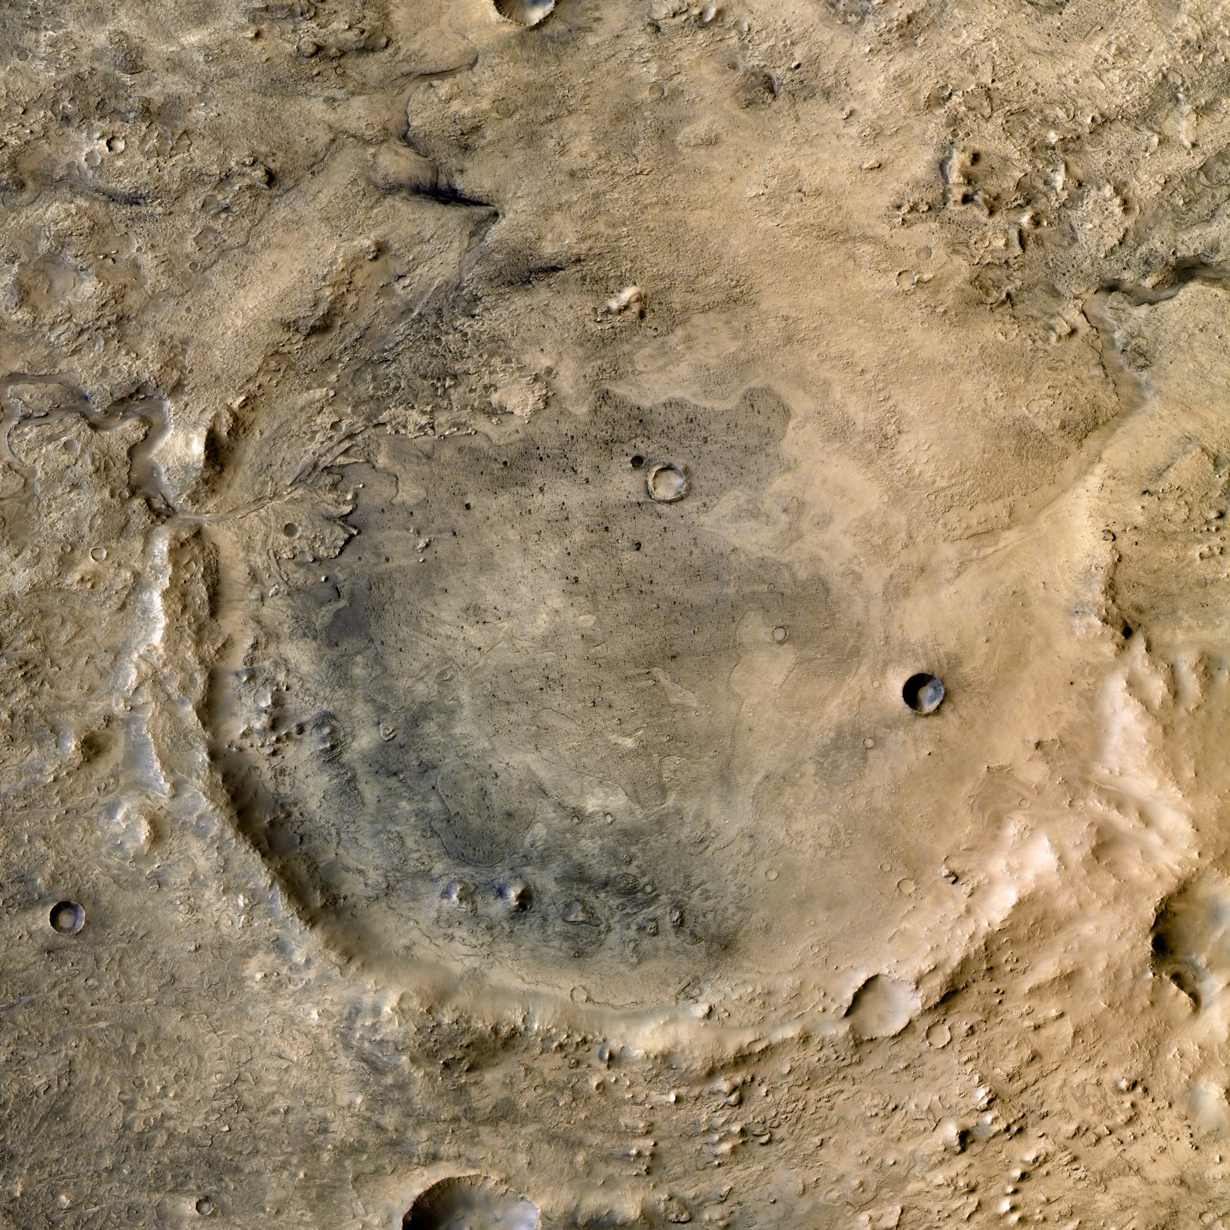
Methods
Visible Near-Infrared (VNIR) Spectrometer
Fourier-Transform Infrared (FTIR) Spectrometer
Mid-Infrared (MIR)
Prepare mixtures
Generate high-quality laboratory spectra

Slide 4
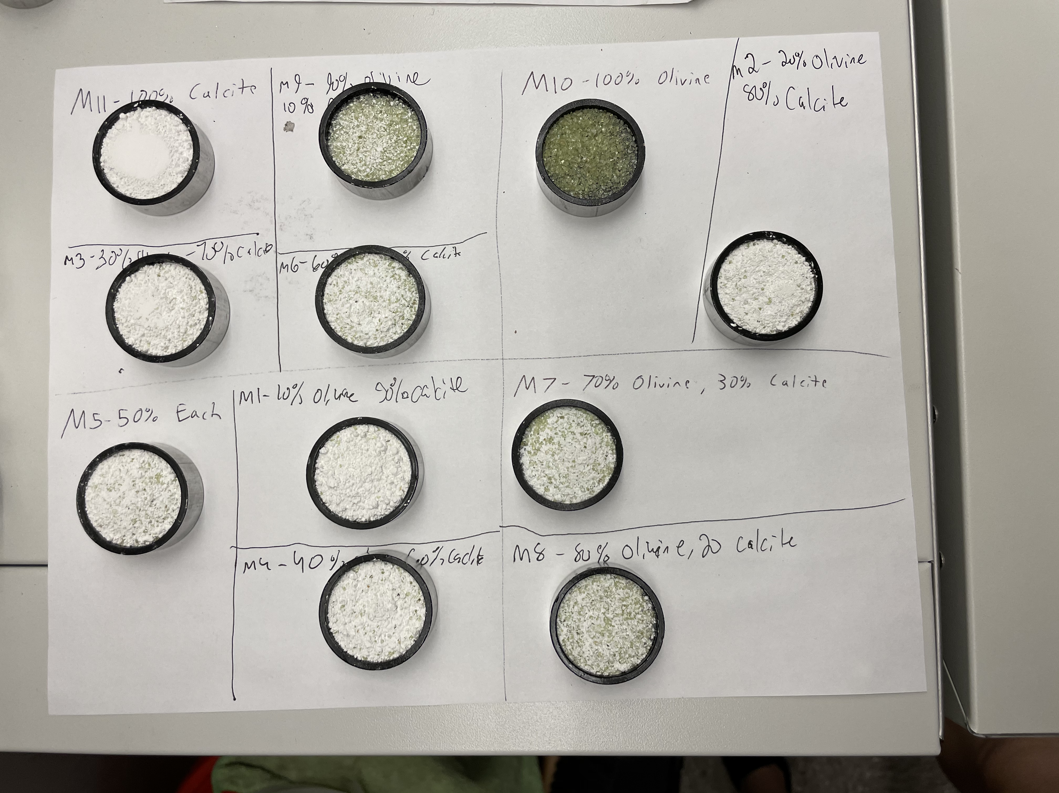
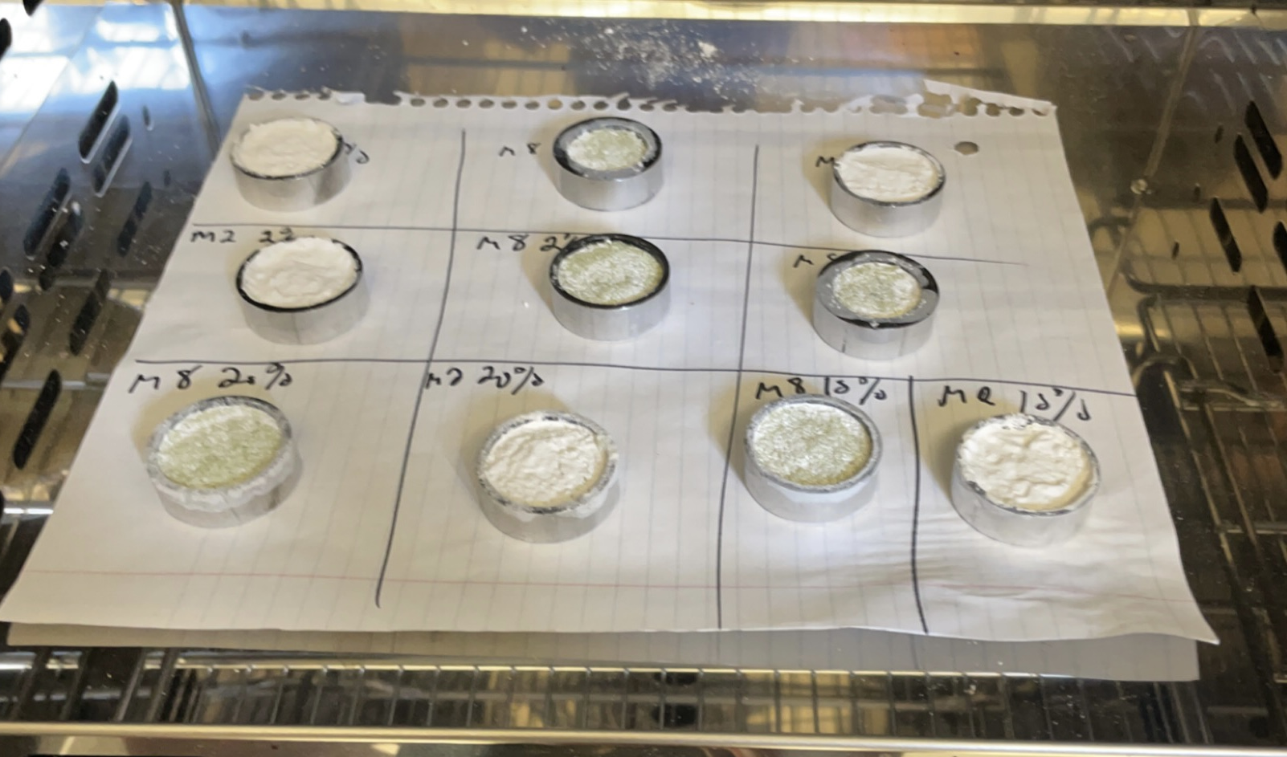
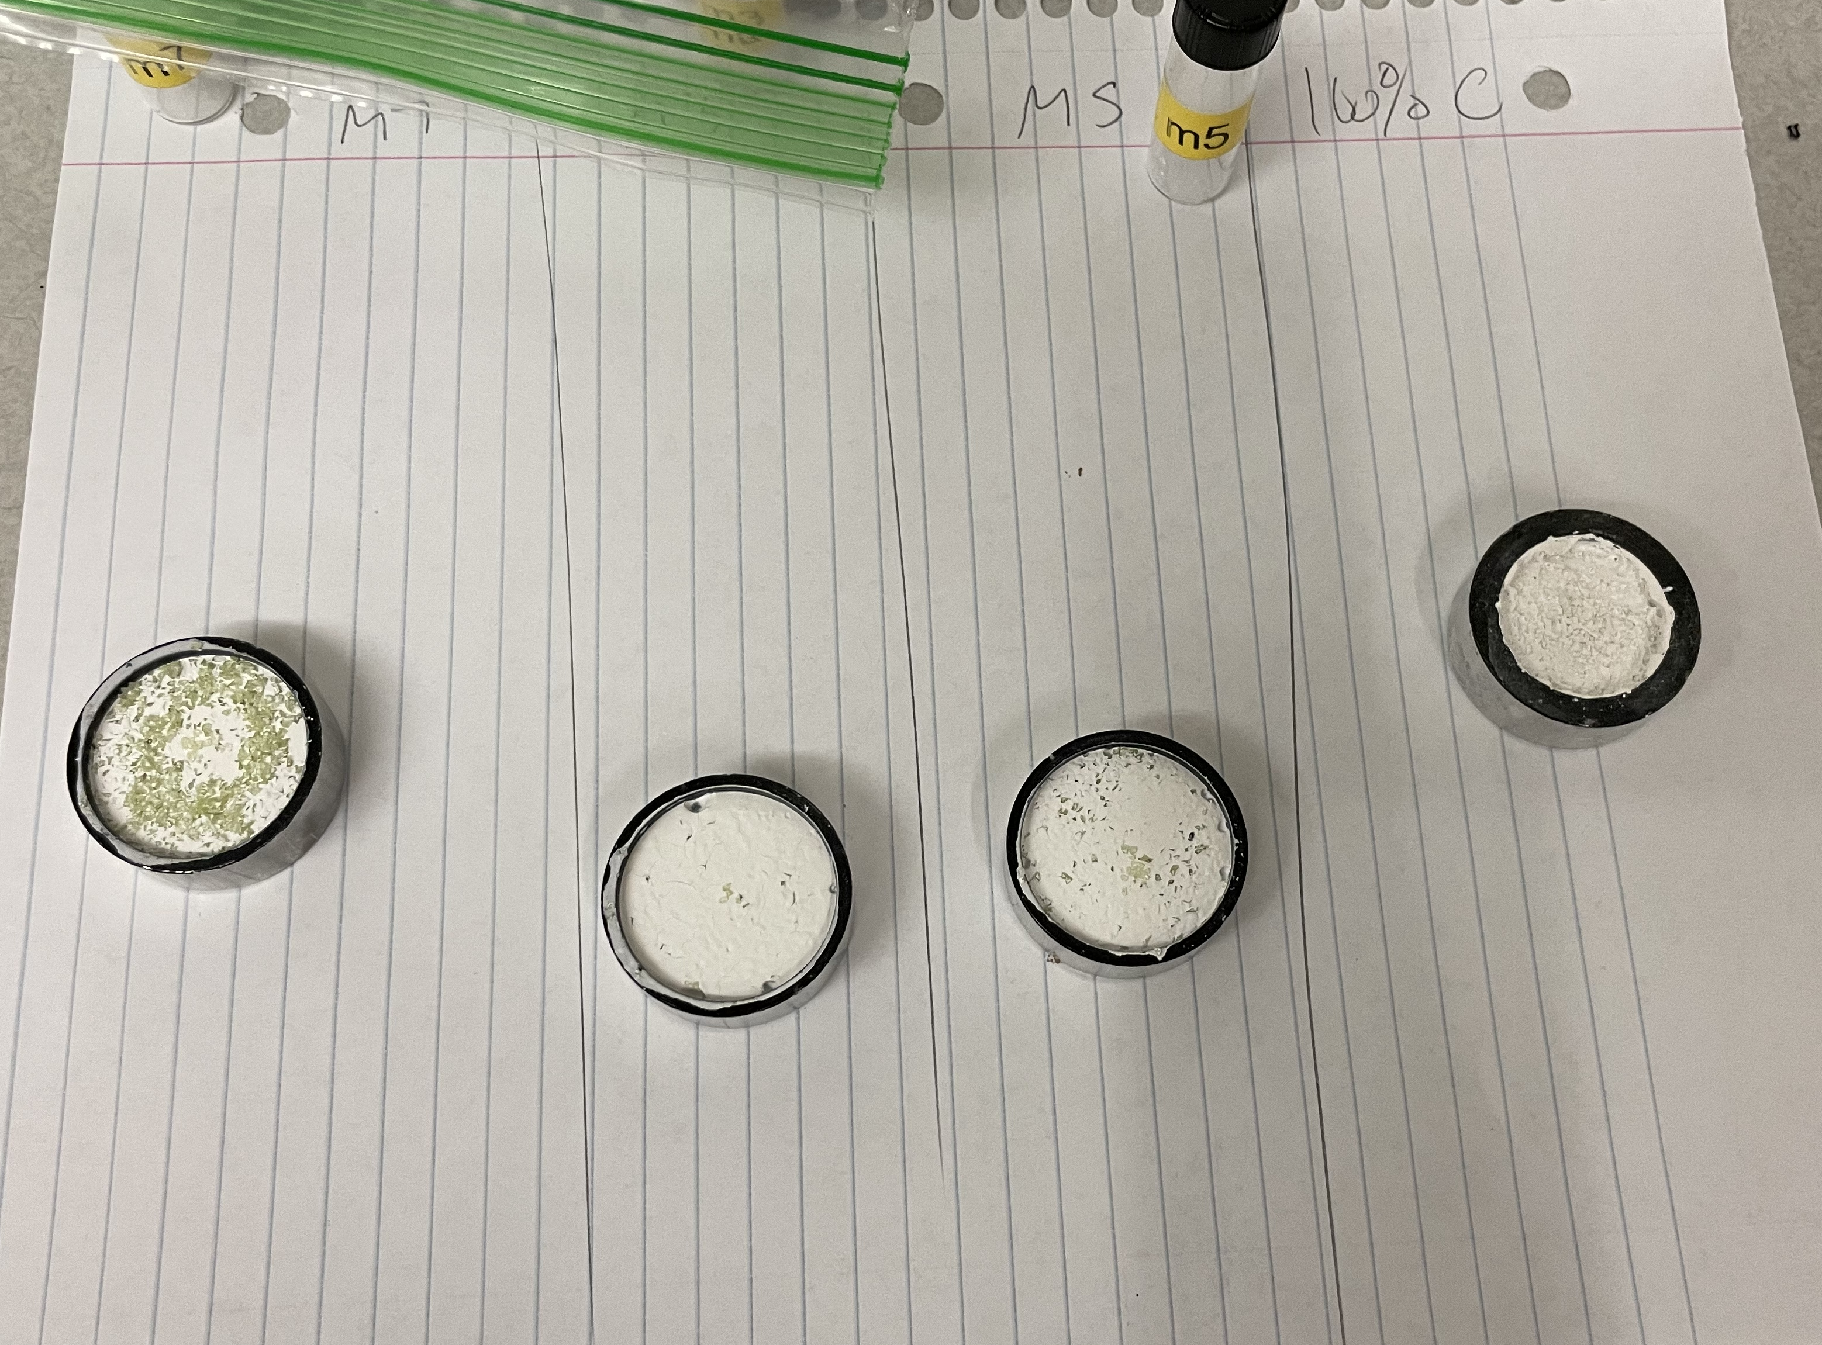
Samples

Slide 5
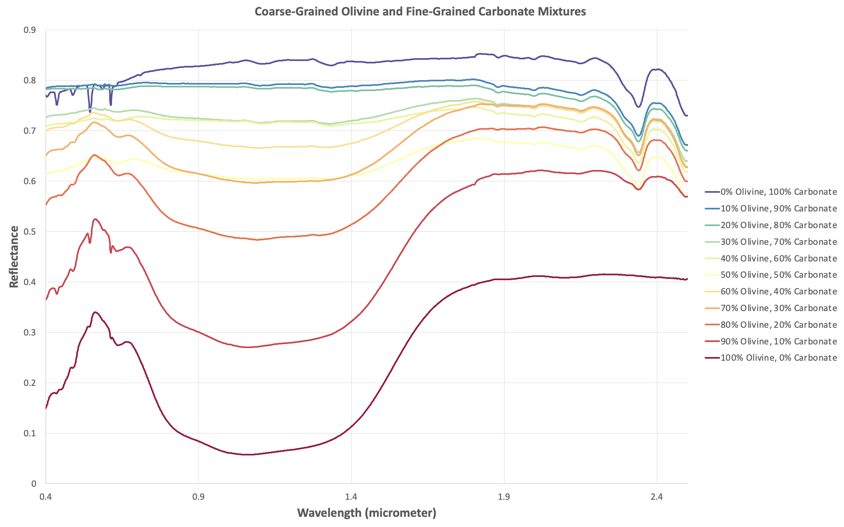
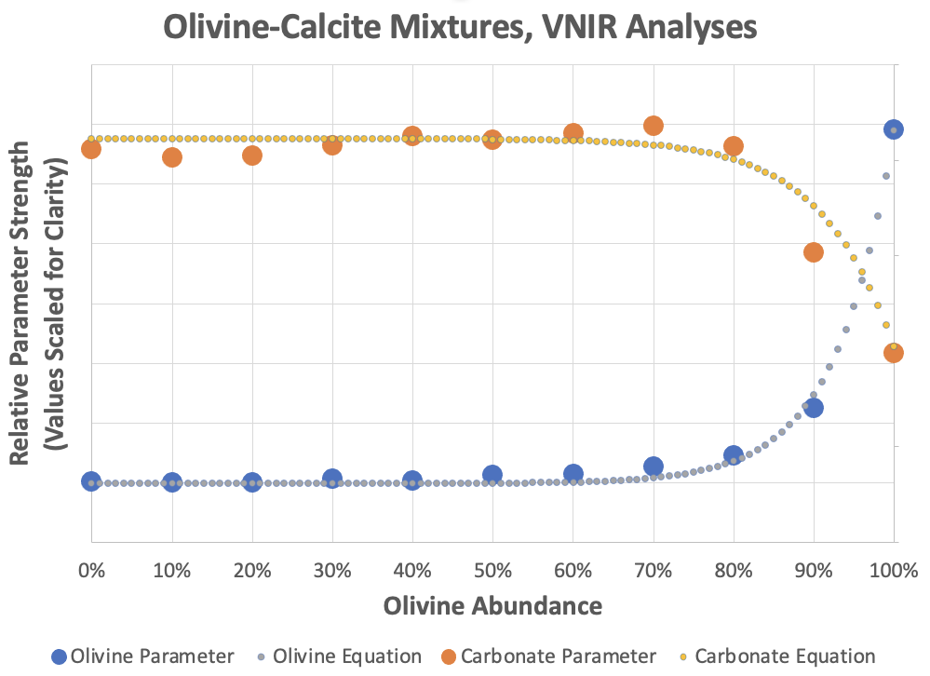
Early Research Findings

Slide 6
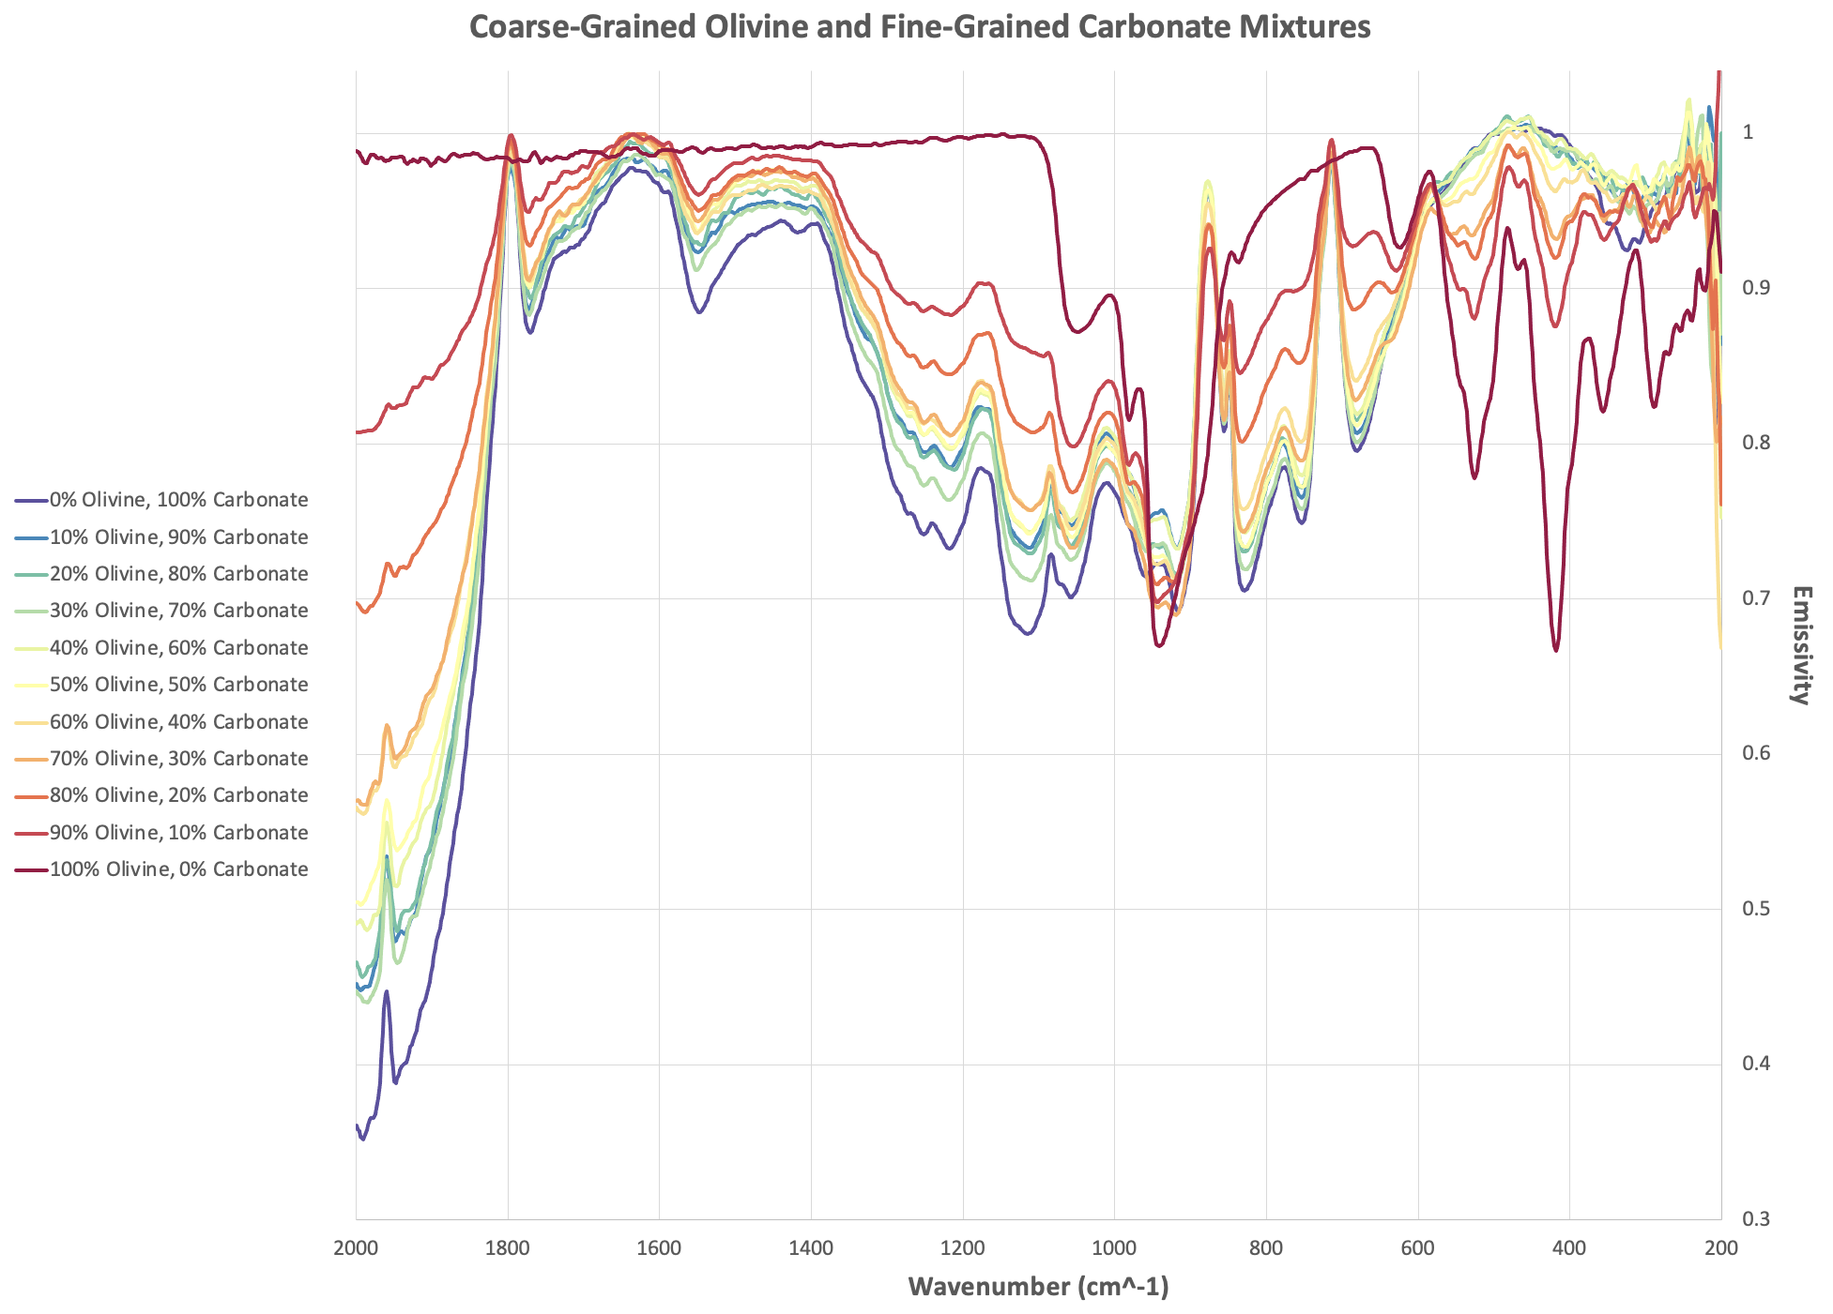
Early Research

Slide 7
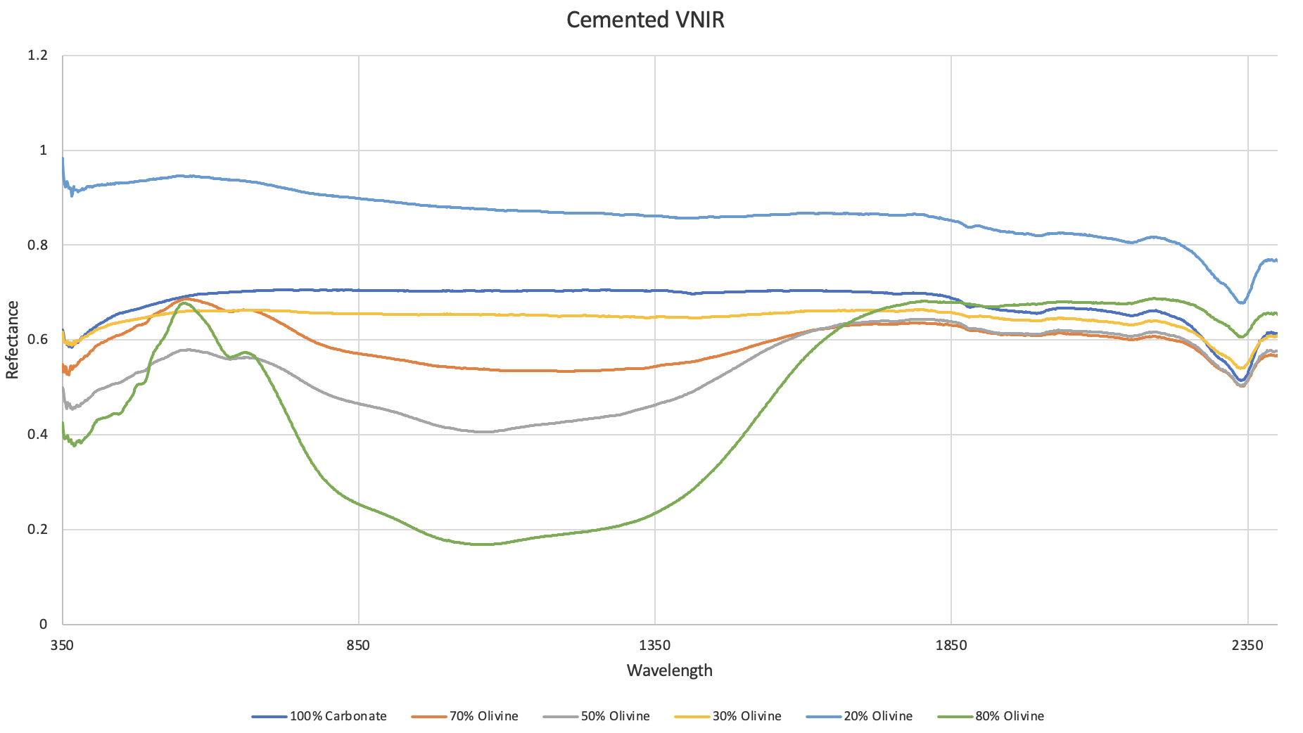
VNIR Cemented Data

Slide 8
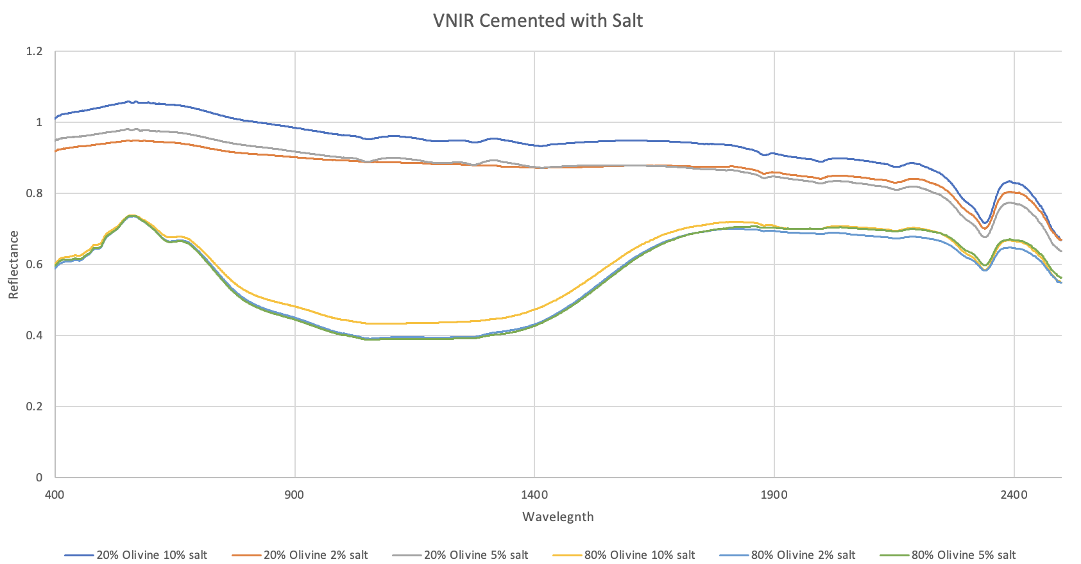
VNIR Cemented with Salt Data

Slide 9
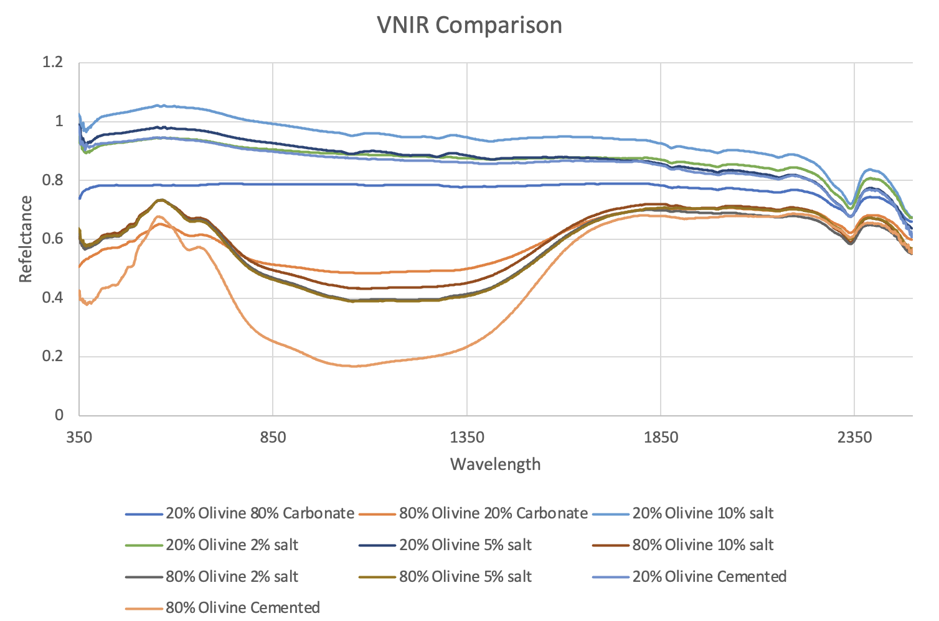
VNIR Comparison

Slide 10
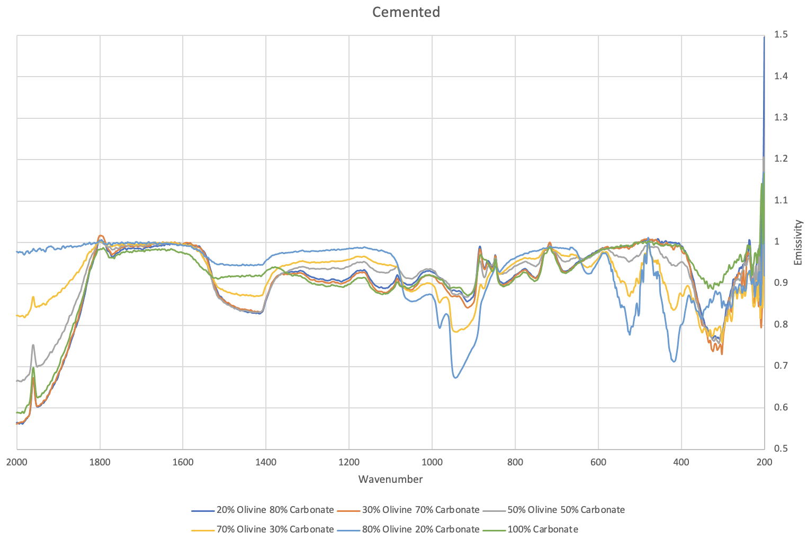
FTIR Cemented Data

Slide 11
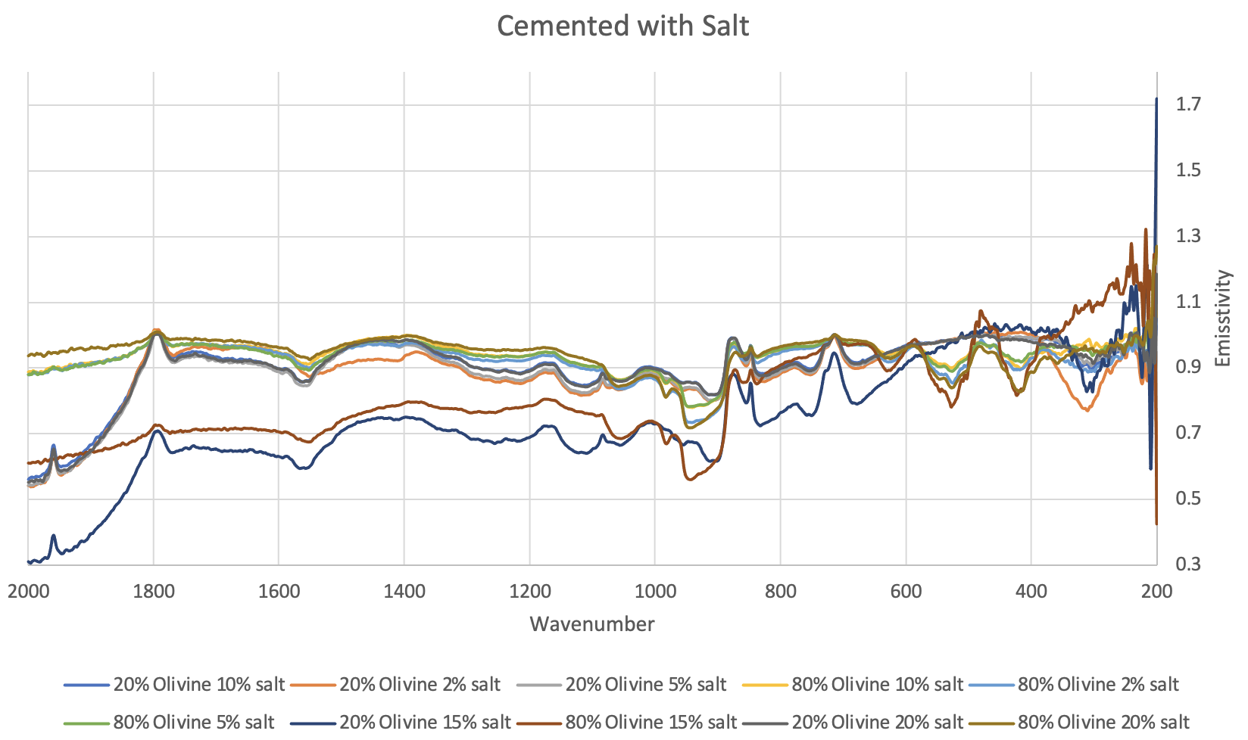
FTIR Cemented with Salt data

Slide 12
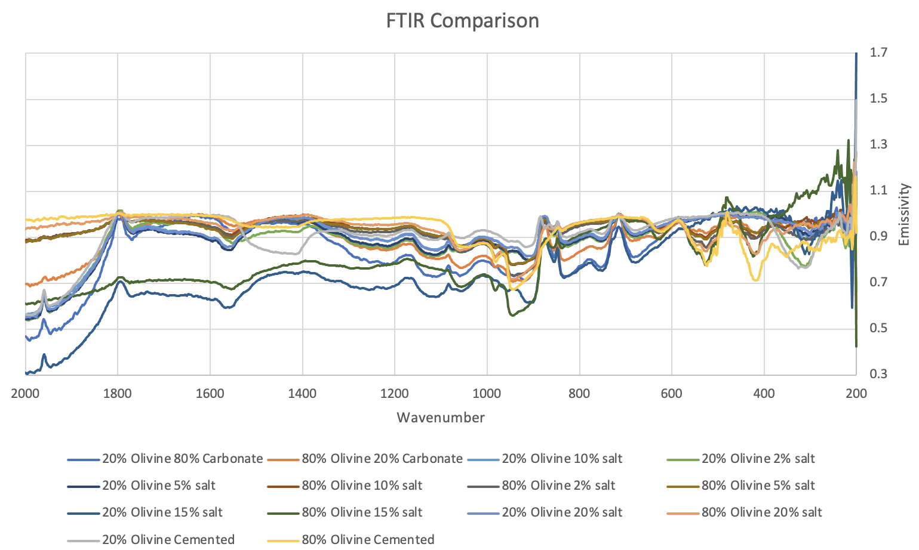
FTIR Comparison

Slide 13
What’s next
Cemented FLIR and FTIR data
Investigating the FLIR with the FTIR
Current Thoughts
Relating back to rover and satellite data
Paper

Slide 14
Questions?

